Slide 1

Mario Time Machine
Igor Carvalho & Kayla Cinnamon
Notes:
Kayla

Slide 2

Design
Concept
1
Notes:
Kayla

Slide 3


Design Concept
In-game time machine
Time travel through different versions of Mario
From 1985 to 2017
Start in 2017
Unlock new worlds, moving earlier and earlier
Super Mario Bros.
1985
Notes:
Kayla

Slide 4
Design Concept
We’ve both played different versions of Mario
Keep it true to Mario
Considered using mushrooms
Pipes imply transportation
Super Mario Bros.
1985
Notes:
Kayla

Slide 5
Technology
2
Notes:
Kayla

Slide 6
Technology
PC and mobile
Different from previous Mario platforms
Swiping and clicking functionality is easier than with controller
An homage to old Mario with new technology
More easily accessible
Developed in Unity
Notes:
Kayla

Slide 7
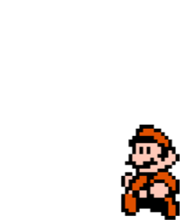
User Analysis
3
Notes:
Kayla

Slide 8
User Analysis
Mario lovers
Stay true to the franchise
Mobile and PC gamers
Have intuitive controls
Tap and swipe; WASD and spacebar
Previous experience is not required
Notes:
Kayla

Slide 9
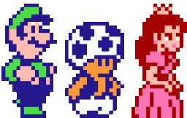
User Analysis
PC is Mario
Actions are the same as the how they were in year the user is playing in
NPCs will act the way they did in the year the user is playing in
Notes:
Kayla

Slide 10

User Experience
4
Notes:
Kayla

Slide 11
User Experience
Game begins in 2017 - Super Mario Odyssey
Player traverses level
Final checkpoint is green tube with new unlocked level
2015 - Super Mario Maker
Player wins the game when they reach and complete last level in 1985 - Super Mario Bros
At any time, the player can revisit times they’ve unlocked by swiping/clicking on green tube or going to the main menu
Notes:
Kayla

Slide 12

Use Cases
5
Notes:
Igor

Slide 13

Use Cases
Sally - 14 years old on iPhone X
Just installed the game
Activation
Complete Level 1 and reach the end
Browsing destinations
Swipe on tube
Setting coordinates
Displayed version is the set coordinate
Level 2: 2015 - Super Mario Maker
Translocation
Jump into the tube
Deactivation
Appears at end of level so Sally needs to complete
the next level
Super Mario Bros.
1985
Notes:
Igor

Slide 14
Use Cases
Jim - 21 years old using Lenovo PC, has already reached Level 4
By doing so he has unlocked a new area on the newest version of Mario (Level 1 - 2017)
Activation
Open map view with all levels shown
Browsing destinations
Look through completed levels
Setting coordinates
Click on new area stemming from Level 1
Translocation
Additional level loads and Jim can play in 2017
Deactivation
Map disappears and Jim would have to open it again to travel back in time
Notes:
Igor

Slide 15
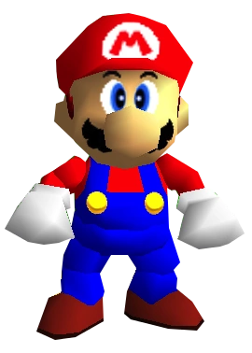
Interface
6
Notes:
Igor

Slide 16
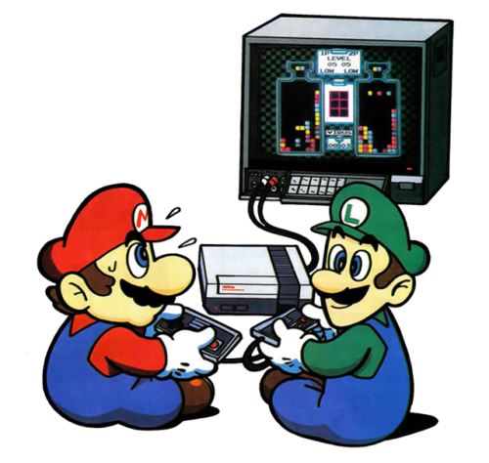
Interface
Live demo!
Notes:
Igor

Slide 17
Interface System Analysis
7
Notes:
Igor

Slide 18
Interface System Analysis
Create a game true to Mario
Green pipe is a classic transportation method
Playing through levels gives incentive to play the game and earn the older versions
Time machine is purely visual
Intended to blend into the game and be an intuitive part of gameplay
Notes:
Igor

Slide 19

Thanks!
Any questions?
Notes:
Igor

